Slide 1
Convergence problem on Cadence

Slide 2
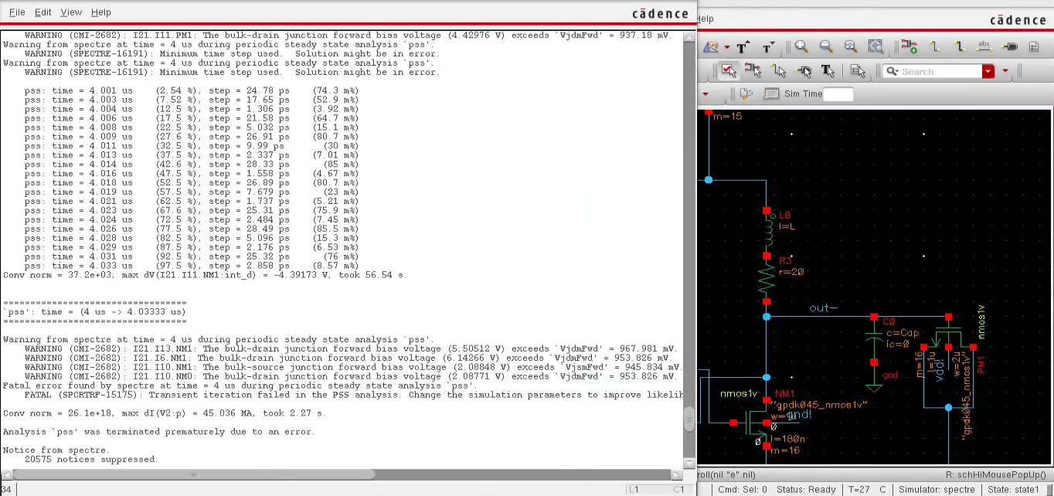
Example

Slide 3
Useful Links
https://community.cadence.com/cadence_technology_forums/f/custom-ic-design/29141/convergence-error-in-transient-analysis
http://ecee.colorado.edu/~ecen5807/hw/hw6/SpiceConvergenceTips.html

Slide 4
The following set of suggestions might help you avoid convergence difficulties.
Evaluate and resolve any notice, warning, or error messages.
Use realistic device models. Check all component parameters, particularly nonlinear device model parameters, to ensure that they are reasonable.
Small floating resistors connected to high impedance nodes might cause convergence difficulties. Avoid very small floating resistors, particularly small parasitic resistors in semiconductors. Instead, use voltage sources or iprobes to measure current.
Ensure that a complete set of parasitic capacitors is used on nonlinear devices to avoid jumps in the solution waveforms. On MOS models, specify nonzero source and drain areas.
Perform sanity check on the parameter values using the parameter range checker (use ``+param param-limits-file'' as a command line argument) and heed any warnings. Print the minimum and maximum parameter value using the `info' analysis. Ensure that the bounds given for instance, model, output, temperature-dependent, and operating-point (if possible) parameters are reasonable.
Check the direction of both independent and dependent current sources. Convergence problems might result if current sources are connected such that they force current backward through diodes.
Enable diagnostic messages by setting option `diagnose=yes’.
Use the `cmin' parameter to install a small capacitor from every node in the circuit to ground. This usually eliminates any jumps in the solution.
Loosen tolerances, particularly absolute tolerances like `iabstol' (on options statement). If tolerances are set too tight, they might preclude convergence.
Try to simplify the nonlinear component models in order to avoid regions in the model that might contribute to convergence problems.

Slide 5
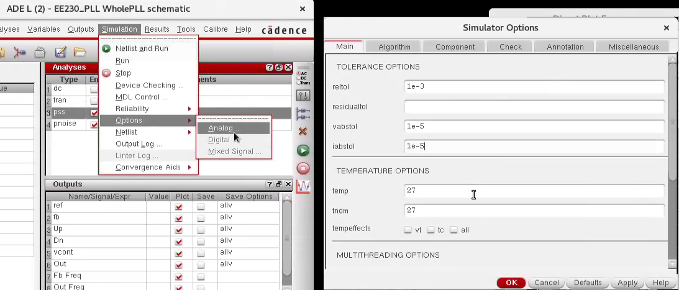
Things that I used in the EE230 project to prevent convergence problems
Increasing iabstol & vabstol

Slide 6
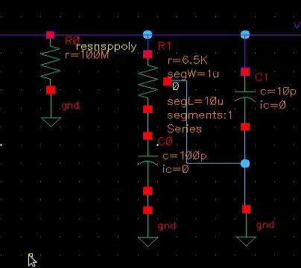
Things that I used in the EE230 project to prevent convergence problems
Adding a hue resistance (100MOhms) at certain nodes.

Slide 7
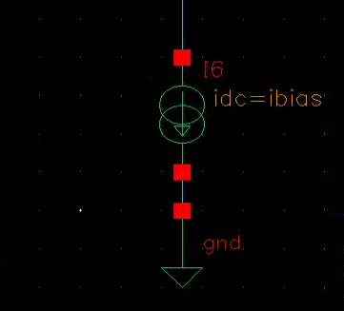

Things that I used in the EE230 project to prevent convergence problems
Replace the realistic current sources with ideal ones.

